Slide 1
Basic Troubleshooting

Slide 2
Tools for Troubleshooting
Only make a measurement when normal value is known
Ohmmeter
Determines an open or short circuit
Voltmeter
Measures voltage drop across a component

Slide 3
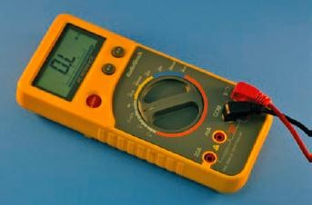
Tools for Troubleshooting (cont’d.)
Figure 40-1. Ohmmeter

Slide 4
Tools for Troubleshooting (cont’d.)
Ammeter
Measures current flow
For entire circuit
Through individual components
Oscilloscope
Essential for advanced troubleshooting
Detects presence or absence of a signal

Slide 5
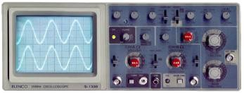
Tools for Troubleshooting (cont’d.)
Figure 40-4. Oscilloscope

Slide 6
Tools for Troubleshooting (cont’d.)
Isolation transformer
Isolates circuit that does not use a transformer for its power supply
Soldering iron, solder, and desoldering tools
For removing and replacing components in a printed circuit board

Slide 7
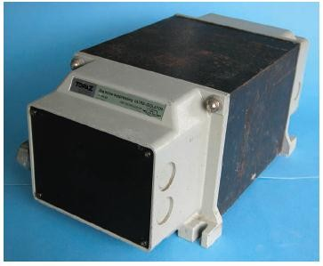
Tools for Troubleshooting (cont’d.)
Figure 40-5. Isolation transformer.

Slide 8
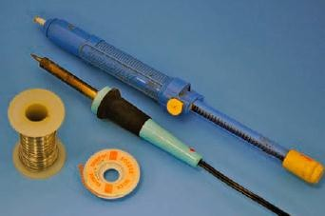
Tools for Troubleshooting (cont’d.)
Figure 40-6. Tools for successful repairing of a printed circuit board.

Slide 9
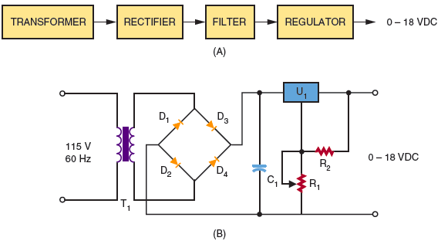
Figure 40-7. Types of wiring diagrams.

Slide 10
Isolation Techniques for Effective Troubleshooting
Step one
Manually check the printed circuit before power is applied
Step two
Apply power to determine if an electrical problem exists

Slide 11
Isolation Techniques for Effective Troubleshooting (cont’d.)
Step three
Troubleshoot
Eyesight, smell, listen, and touch
Step four
Determine if circuit will work when exposed to its environment

Slide 12
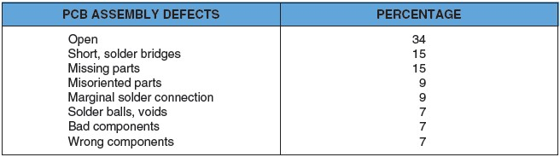
Common Types of Defects
Figure 40-8. Common defects of printed circuit board assembly.

Slide 13
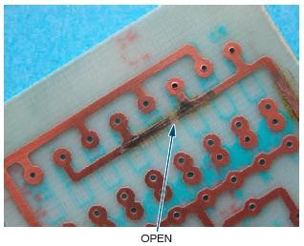
Common Types of Defects (cont’d.)
Figure 40-9. Open on a printed circuit board.

Slide 14
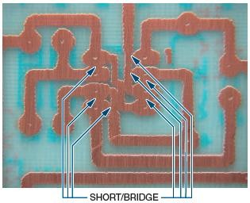
Common Types of Defects (cont’d.)
Figure 40-10. Shorts on a printed circuit board.

Slide 15
Troubleshooting Tips
Start with the power of observation
Do not assume a problem is complex
If a problem is difficult, step away to think
Touch a ground point to prevent ESD

Slide 16
Documentation
Schematic diagram
Most important document when troubleshooting
Shows how circuit is connected
Shows voltage drops in a circuit
Shows waveforms at various test points
Secret of successful troubleshooting
Good documentation

